Slide 1
Modern Systems Analysis
and Design
Sixth Edition
Jeffrey A. Hoffer
Joey F. George
Joseph S. Valacich
Chapter 7
Structuring System Process Requirements

Slide 2
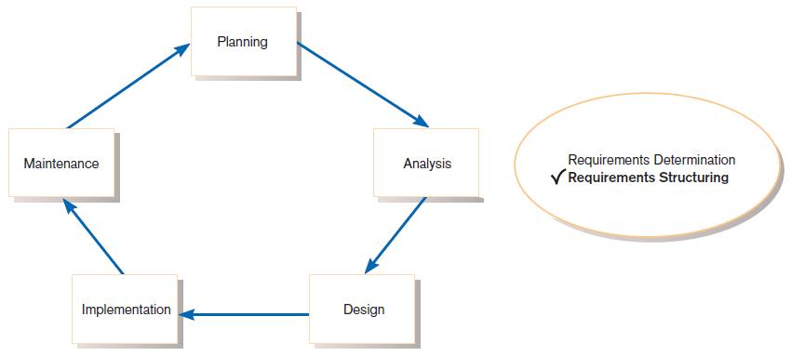
Process Modeling
FIGURE 7-1
Systems development life cycle with the analysis phase highlighted

Slide 3
Process Modeling
Graphically represent the processes that capture, manipulate, store, and distribute data between a system and its environment and among system components.
Utilize information gathered during requirements determination.
Processes and data structures are modeled.

Slide 4
Deliverables and Outcomes
Context data flow diagram (DFD)
  Scope of system
DFDs of current physical system
  Adequate detail only
DFDs of current logical system
  Enables analysts to understand current system

Slide 5
Deliverables and Outcomes (Cont.)
DFDs of new logical system
  Technology independent
  Show data flows, structure, and functional requirements of new system
Thorough description of each DFD component

Slide 6
Data Flow Diagramming Mechanics
Represent both physical and logical information systems
Only four symbols are used
Useful for depicting purely logical info flows
DFD’s that detail physical systems differs from system flow chart that depict detail of physical computing equipment

Slide 7
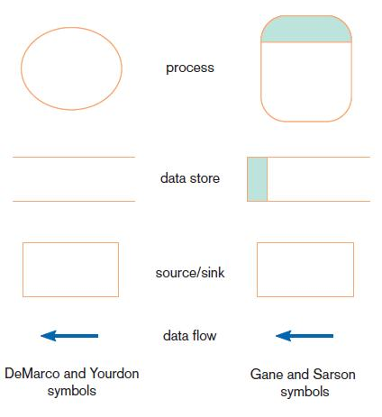
Definitions and Symbols
FIGURE 7-2
Comparison of DeMarco and Yourdon
and Gane and Sarson DFD symbol sets

Slide 8
Definitions and Symbols (Cont.)
Process: work or actions performed on data (inside the system)
Data store: data at rest (inside the system)
Source/sink: external entity that is origin or destination of data (outside the system)
Data flow: arrows depicting movement of data

Slide 9
Developing DFDs
Context diagram is an overview of an organizational system
that shows:
  the system boundaries.
  external entities that interact with the system.
  major information flows between the entities and the system.
Note: only one process symbol, and no data stores shown

Slide 10
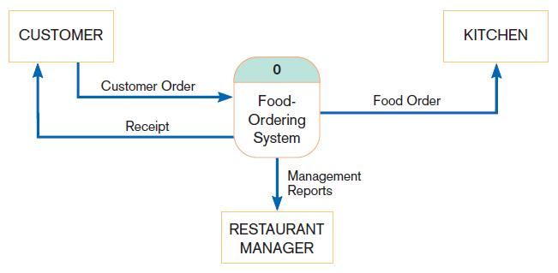
Context Diagram
FIGURE 7-4
Context diagram of Hoosier Burger’s food-ordering system

Slide 11
Developing DFDs (Cont.)
Level-0 diagram is a data flow diagram that represents a system’s major processes, data flows, and data stores at a high level of detail.
  Processes are labeled 1.0, 2.0, etc. These will be decomposed into more primitive (lower-level) DFDs.

Slide 12
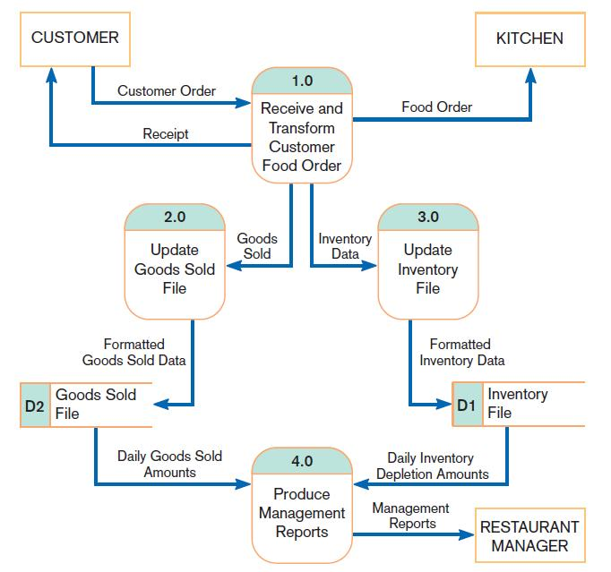
Level-0 Diagram
copy of same data goes from same source to multiple destinations
FIGURE 7-5
Level-0 DFD of Hoosier Burger’s food-ordering system
Error msg

Slide 13
Data Flow Diagramming Rules
There are two DFD guidelines that apply:
  The inputs to a process are different from the outputs of that process.
    Processes purpose is to transform inputs into outputs.
  Objects on a DFD have unique names.
    Every process has a unique name.

Slide 14
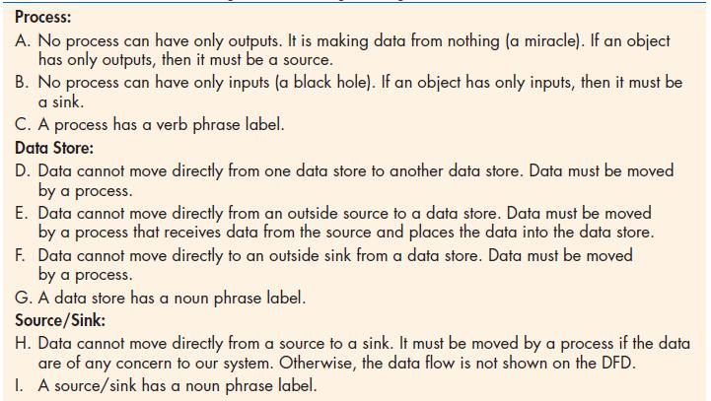
Data Flow Diagramming Rules (Cont.)
TABLE 7-2 Rules Governing Data Flow Diagramming

Slide 15
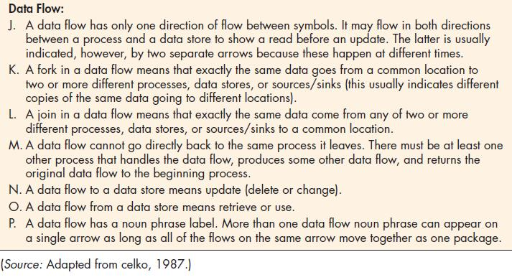
Data Flow Diagramming Rules (Cont.)
TABLE 7-2 Rules Governing Data Flow Diagramming (cont.)
daily good sold
should move together as one package
daily good sth else

Slide 16
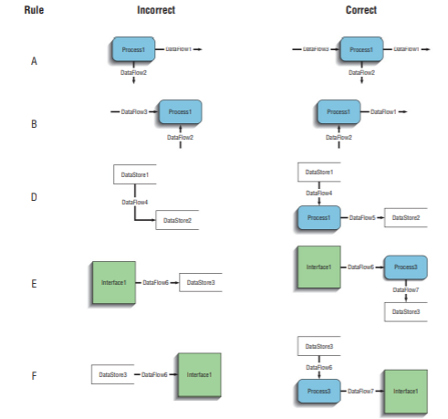
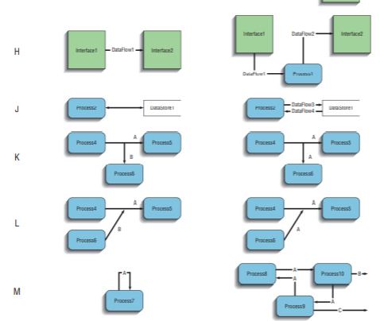

Slide 17
Decomposition of DFDs
Functional decomposition is an iterative process of breaking a system description down into finer and finer detail.
  Creates a set of charts in which one process on a given chart is explained in greater detail on another chart.
  Continues until no subprocess can logically be broken down any further.

Slide 18
Decomposition of DFDs (Cont.)
Primitive DFD is the lowest level of a DFD.
Level-1 diagram results from decomposition of Level-0 diagram.
Level-n diagram is a DFD diagram that is the result of n nested decompositions from a process on a level-0 diagram.

Slide 19
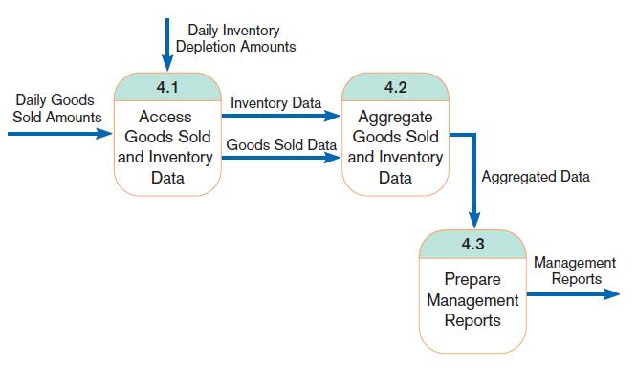
Level-1 DFD
FIGURE 7-8
Level-1 diagram showing the decomposition of Process 4.0 from the level-0 diagram for Hoosier Burger’s food-ordering system
Level-1 DFD shows the sub-processes of one of the processes in the Level-0 DFD.
This is a Level-1 DFD for Process 4.0.
Processes are labeled 4.1, 4.2, etc. These can be further decomposed in more primitive (lower-level) DFDs if necessary.

Slide 20
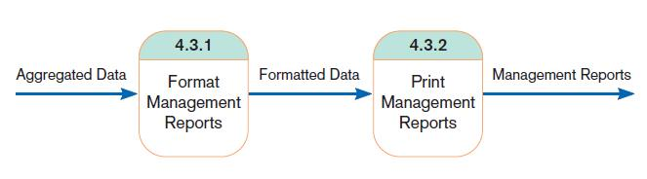
Level-n DFD
FIGURE 7-9
Level-2 diagram showing the decomposition of Process 4.3 from the level-1 diagram for Process 4.0 for Hoosier Burger’s food-ordering system
Level-n DFD shows the sub-processes of one of the processes in the Level n-1 DFD.
This is a Level-2 DFD for Process 4.3.
Processes are labeled 4.3.1, 4.3.2, etc. If this is the lowest level of the hierarchy, it is called a primitive DFD.

Slide 21
Balancing DFDs
Conservation Principle: conserve inputs and outputs to a process at the next level of decomposition
Balancing: conservation of inputs and outputs to a data flow diagram process when that process is decomposed to a lower level

Slide 22
Balancing DFDs (Cont.)
Balanced means:
  Number of inputs to lower level DFD equals number of inputs to associated process of higher-level DFD
  Number of outputs to lower level DFD equals number of outputs to associated process of higher-level DFD

Slide 23
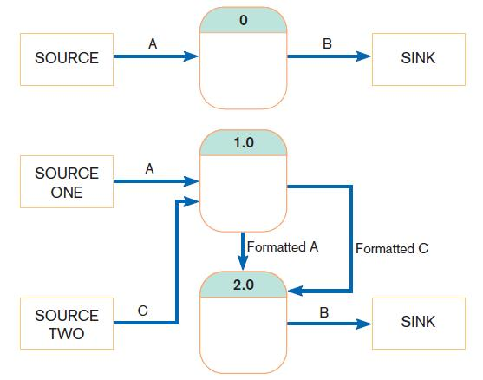
Balancing DFDs (Cont.)
FIGURE 7-10 An unbalanced set of data flow diagrams
(a) Context diagram
1 input
1 output
This is unbalanced because the process of the context diagram has only one input but the Level-0 diagram has two inputs.
(b) Level-0 diagram
2 inputs
1 output

Slide 24
Balancing DFDs (Cont.)
Data flow splitting is when
a composite data flow at a higher level is split and different parts go to different processes in the lower level DFD.
The DFD remains balanced because
the same data is involved, but split into two parts

Slide 25
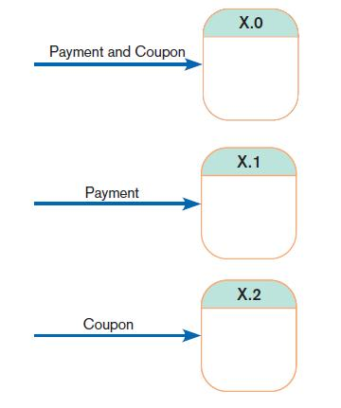
Balancing DFDs (Cont.)
FIGURE 7-11
Example of data flow splitting
(a) Composite data flow
(b) Disaggregated data flows

Slide 26
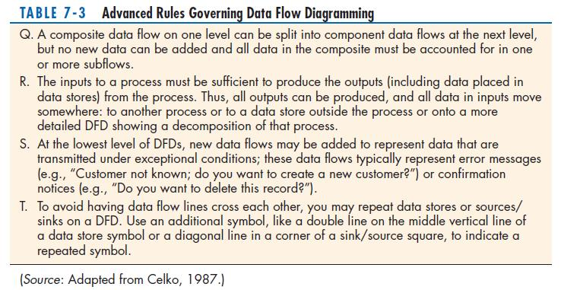
Balancing DFDs: More DFD Rules

Slide 27
Four Different Types of DFDs
Current Physical
  Process labels identify technology (people or systems) used to process the data.
  Data flows and data stores identify actual name of the physical media.
Current Logical
  Physical aspects of system are removed as much as possible.
  Current system is reduced to data and processes that transform them(data).

Slide 28
Four Different Types of DFDs (Cont.)
New Logical
  Includes additional functions.
  Obsolete functions are removed.
  Inefficient data flows are reorganized.
New Physical
  Represents the physical implementation of the new system.

Slide 29
Guidelines for Drawing DFDs
Completeness
  DFD must include all components necessary for system.
  Each component must be fully described in the project dictionary or CASE repository.
Consistency
  The extent to which information contained on one level of a set of nested DFDs is also included on other levels

Slide 30
Guidelines for Drawing DFDs (Cont.)
Timing
  Time is not represented well on DFDs.
  Best to draw DFDs as if the system has never started and will never stop.
Iterative Development
  Analyst should expect to redraw diagram several times before reaching the closest approximation to the system being modeled.

Slide 31
Guidelines for Drawing DFDs (Cont.)
Primitive DFDs
  Lowest logical level of decomposition
  Decision has to be made when to stop decomposition

Slide 32
Guidelines for Drawing DFDs (Cont.)
Rules for stopping decomposition
  When each process has been reduced to a single decision, calculation or database operation
  When each data store represents data about a single entity
  When the system user does not care to see any more detail
  When every data flow does not need to be split further to show that data are handled in various ways
  When you believe that you have shown each business form or transaction, online display and report as a single data flow
  When you believe that there is a separate process for each choice on all lowest-level menu options

Slide 33
Using DFDs as Analysis Tools
Gap Analysis is the process of discovering discrepancies between two or more sets of DFDs or discrepancies within a single DFD.
Inefficiencies in a system can often be identified through? DFDs.

Slide 34
Modeling Logic with Decision Tables
Decision table: a matrix representation of the logic of a decision which specifies the possible conditions for the decision and the resulting actions.
Best used for complicated decision logic.

Slide 35
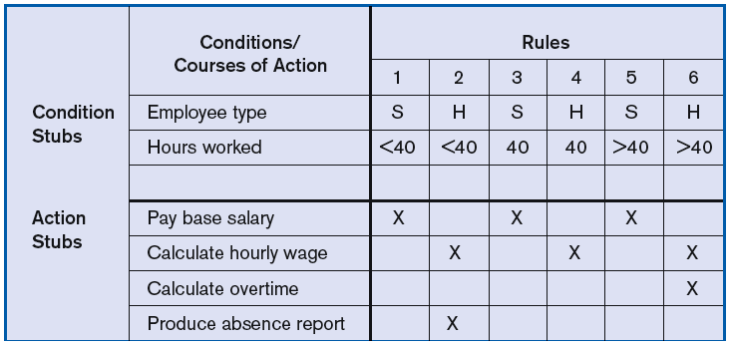
Modeling Logic with Decision Tables (Cont.)
FIGURE 7-18
Complete decision table for payroll system example

Slide 36
Modeling Logic with Decision Tables (Cont.)
Condition stubs: that part of a decision table that lists the conditions relevant to the decision
Action stubs: that part of a decision table that lists the actions that result for a given set of conditions
Rules: that part of a decision table that specifies which actions are to be followed for a given set of conditions
Indifferent condition: in a decision table, a condition whose value does not affect which actions are taken for two or more rules

Slide 37
Modeling Logic with Decision Tables (Cont.)
Procedure for Creating Decision Tables;)
  Name the condition and the values that each condition can assume.
  Name all possible actions that can occur.
  List all possible rules.
  Define the actions for each rule.
  Simplify the table.

Slide 38
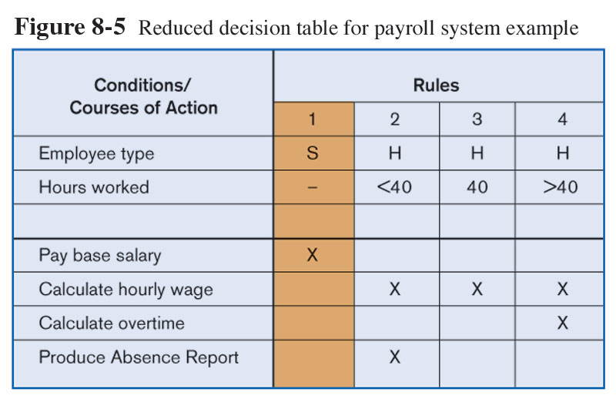
Modeling Logic with Decision Tables (Cont.)
FIGURE 7-19
Reduced decision table for payroll system example

